Slide 1
Pandas
Introduction

Slide 2

Agenda
Introduction
Pandas Series
DataFrame

Slide 3
Pandas
Introduction

Slide 4
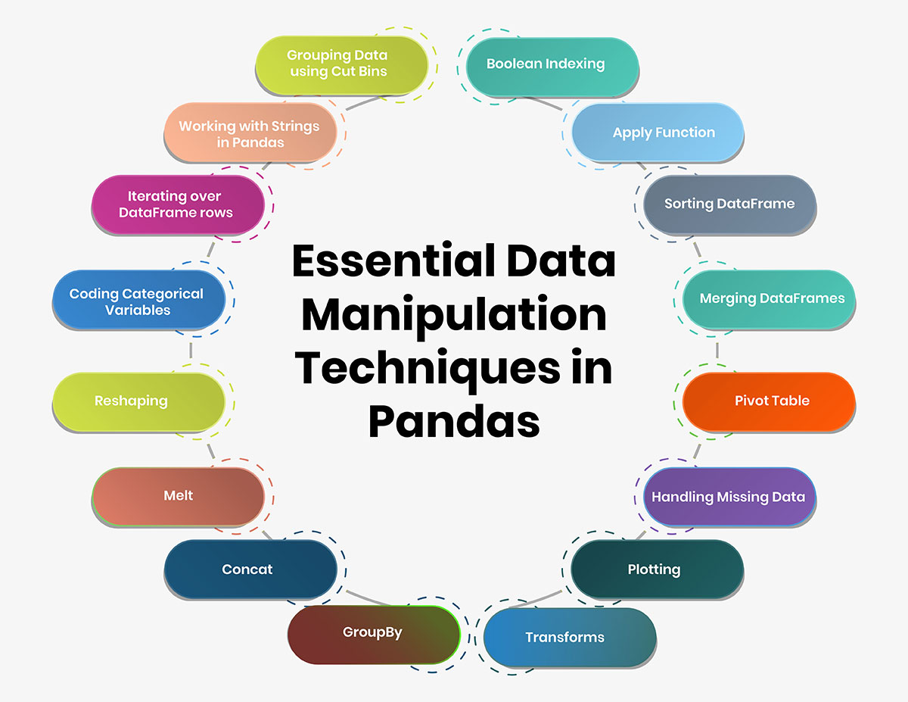
What is Pandas
Pandas
Pandas is an open-source Python library used for:
Organizing data
Cleaning data
Exploring data
Analyzing data
Preparing data for machine learning
Pandas

Slide 5
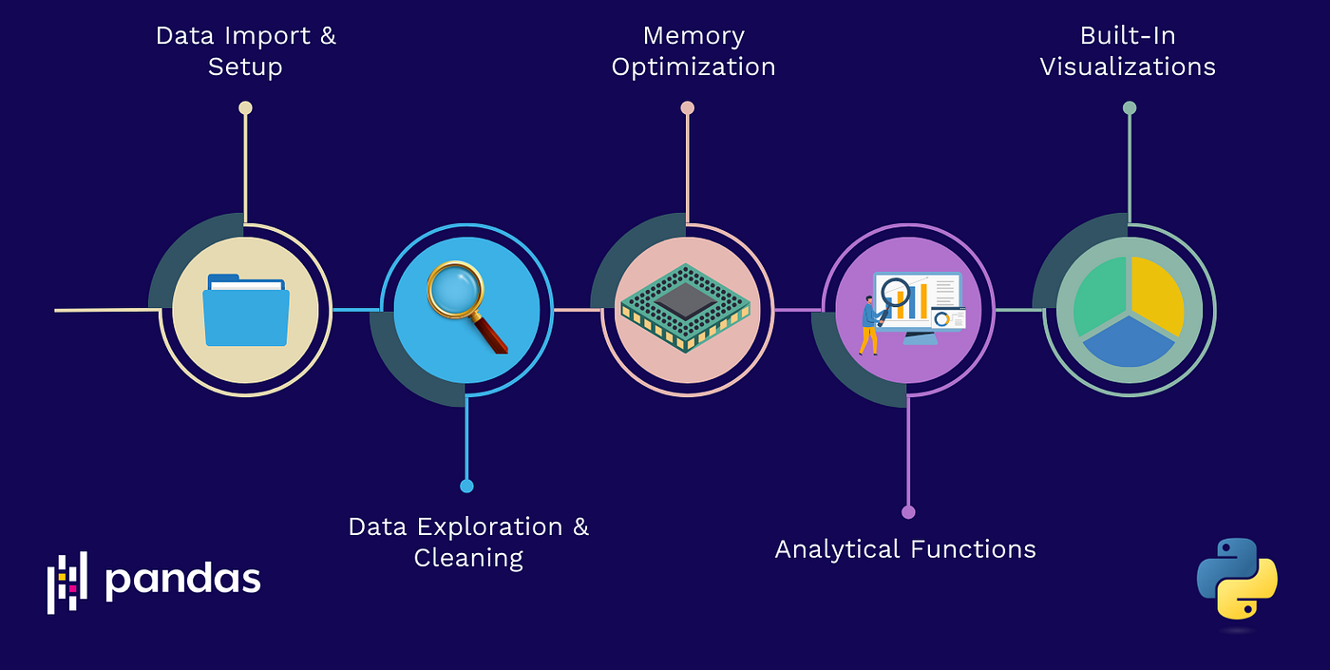
Who Use Pandas
Pandas
Pandas is used by:
Data Analysts
Data Scientists
Business Analysts
Researchers
Machine Learning Engineers
Source

Slide 6
Why not just use Python lists?
Why Use Pandas?
Imagine you are managing data for 10,000 students.
You now have:
10,000 names
10,000 ages
10,000 cities
All stored separately.
As datasets grow, managing separate lists becomes difficult and error-prone.
names = [...]
ages = [...]
cities = [...]
Problem
What happens if:
A student is removed?
A value is inserted incorrectly?
One list becomes shorter?
Everything becomes misaligned.

Slide 7
The Pandas solution: one structured table
Why Use Pandas?
Imagine receiving student data:
Name | Age | City
Abdullah | 22 | Riyadh
Sara | 24 | Jeddah
Ahmed | 21 | Dammam

Slide 8
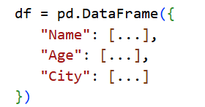
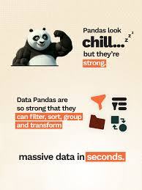
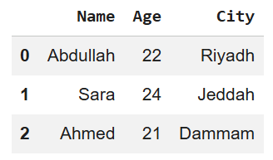
The Pandas solution: one structured table
Why Use Pandas?
With Pandas:
Everything stays together:

Slide 9
Two core structures
Data Structure
Pandas provides two fundamental structures:
DataFrame
Series
ID
Name
Age
City
index
Age
S1
Abdullah
22
Riyadh
S1
22
S2
Sara
24
Jeddah
S2
24
S3
Ahmed
21
Dammam
S3
21
Full table: multiple related columns
One labeled column

Slide 10
Pandas
Series

Slide 11
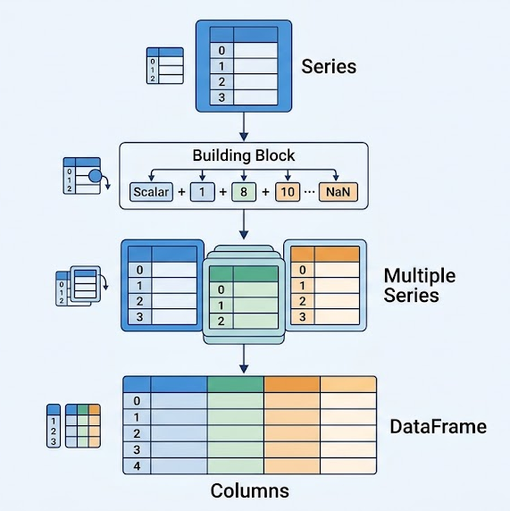
Relation between Series and Dataframe
Pandas Series Intro
A DataFrame is essentially a collection of Series.

Slide 12
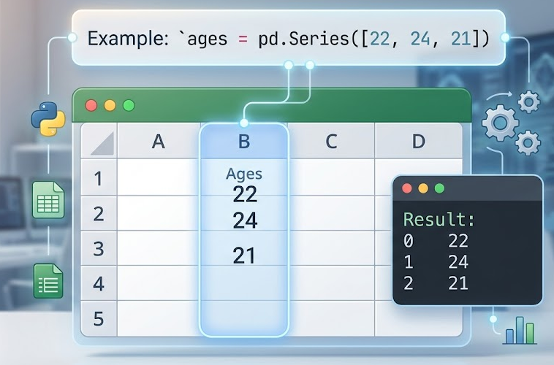
What is Series
Pandas Series: What
A series is:
A one-dimensional labeled array capable of holding any data type.

Slide 13
Every Series Has an Index and Values
Pandas Series: What
Let’s Define a series:
ages = pd.Series([22, 24, 21])
ages.index
# RangeIndex(start=0, stop=3, step=1)
ages.values
# array([22, 24, 21])
Default index
Stored data values

Slide 14
Series with Custom Labels
Pandas Series: Custom Labels
Custom labels make values easier to identify.
ages = pd.Series(
[22, 24, 21],
index=["Abdullah", "Sara", "Ahmed"]
)
Index | Age
Abdullah | 22
Sara | 24
Ahmed | 21
ages["Sara"]
# return 24

Slide 15
When Should You Use a Series?
Pandas Series: When
Use a Series when you are focusing on one column, feature, or measurement.
Analyze one column
Calculate statistics
Age, score, salary, price
mean(), max(), min()
Create filters
Keep row labels
df["Age"] > 21
values stay connected to their index

Slide 16
Simple Series Operations
Pandas Series: Example
ages.mean()
# 22.33
ages.max()
# 24
ages > 21
# Abdullah True
# Sara True
# Ahmed False
These same ideas will appear again when we filter DataFrames.

Slide 17
Pandas
DataFrame

Slide 18
From Series to DataFrame
Series to DataFrame
One Series is useful. Real datasets usually have multiple related Series.
names = pd.Series(["Abdullah", "Sara", "Ahmed"])
ages = pd.Series([22, 24, 21])
cities = pd.Series(["Riyadh", "Jeddah", "Dammam"])
A DataFrame brings related Series together into one table.
 | Name | Age | City
0 | Abdullah | 22 | Riyadh
1 | Sara | 24 | Jeddah
2 | Ahmed | 21 | Dammam

Slide 19
DataFrame
Pandas DataFrame: What
A dataframe is:
Think Of It As
Excel Spreadsheet
SQL Table
Student Records
A two-dimensional tabular structure consisting of rows and columns.
index
columns
 | Name | Age | City
0 | Abdullah | 22 | Riyadh
1 | Sara | 24 | Jeddah
2 | Ahmed | 21 | Dammam
rows

Slide 20
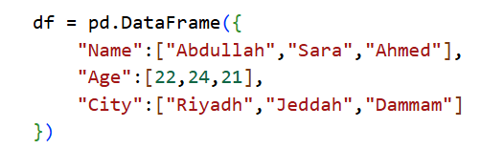
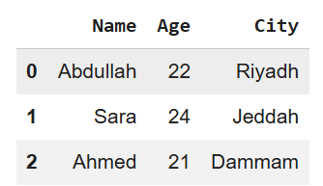
Creating a DataFrame
Pandas DataFrame: Create
Result
A structured table ready for analysis.

Slide 21
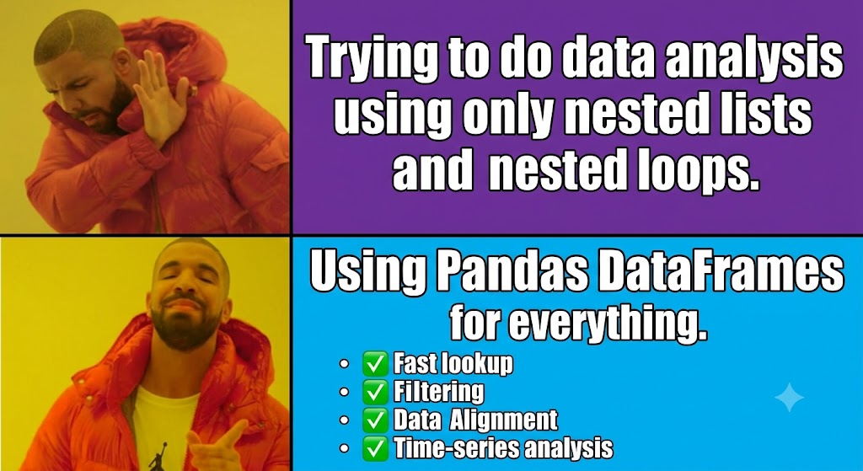
Why Use a DataFrame?
Pandas DataFrame: Why
It keeps related data together and makes analysis easier.
Separate lists
Easy to misalign
Harder to filter
Harder to summarize
Harder to inspect
DataFrame
One structured table
Rows stay together
Columns have names
Built-in analysis tools

Slide 22
When Should You Use a DataFrame?
Pandas DataFrame: When
Use DataFrame when your data has multiple related columns.
CSV / Excel files
Student or customer data
Rows and columns of records
Multiple attributes per person
Filtering rows
Summarizing tables
Find records that match a condition
Calculate averages, counts, and totals
Most Pandas workflows start by loading data into a DataFrame.

Slide 23
Simple DataFrame Statistics
Pandas DataFrame: Example
Pandas can answer table questions with short commands.
 | Name | Age | City
0 | Abdullah | 22 | Riyadh
1 | Sara | 24 | Jeddah
2 | Ahmed | 21 | Dammam
df["Age"].mean()
# 22.33
df["Age"].max()
# 24
df["City"].count()
# 3
df["Age"].min()
# 21

Slide 24

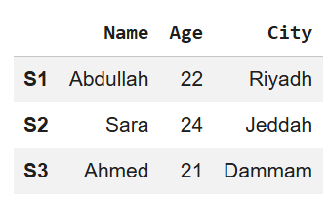
Indexes
DataFrame
Indexes identify rows.
Custom Index:

Slide 25
Pandas
Index

Slide 26
What Is an Index?
Pandas: Index
An index identifies rows or values. Pandas creates one automatically if we do not provide it.
 | Name | Age | City
0 | Abdullah | 22 | Riyadh
1 | Sara | 24 | Jeddah
2 | Ahmed | 21 | Dammam
Default index:
0, 1, 2, ...
Created automatically.
Custom index:
S1, S2, S3
Chosen by us when labels are useful.

Slide 27
The Index Is Also an Object
Pandas: Index
Pandas stores row labels in a separate Index object.
obj = pd.Series(range(3), index=["a", "b", "c"])
obj.index
# Index(["a", "b", "c"], dtype="object")
This means the row labels are stored separately from the values.
obj.index[1:]
# Index(["b", "c"], dtype="object")
You can view and slice an Index just like a sequence.

Slide 28
Default Index vs Custom Index
Pandas: Index
Custom labels can make row access easier to understand.
df.index
# RangeIndex(start=0, stop=3, step=1)
df.index = ["S1", "S2", "S3"]
Index | Name | Age | City
0 | Abdullah | 22 | Riyadh
1 | Sara | 24 | Jeddah
2 | Ahmed | 21 | Dammam
Index | Name | Age | City
S1 | Abdullah | 22 | Riyadh
S2 | Sara | 24 | Jeddah
S3 | Ahmed | 21 | Dammam

Slide 29
Index Labels Are Immutable
Pandas: Index
You can replace the whole index, but you cannot edit one label in place.
index = pd.Index(["a", "b", "c"])
index[1:]
# Index(["b", "c"], dtype="object")
index[1] = "d"
# TypeError
Allowed: viewing and slicing the Index.
Not allowed: changing one label directly.
This rule keeps index labels stable and prevents accidental one-label changes.

Slide 30
Can Index Labels Repeat?
Pandas: Index
Pandas allows duplicate labels by default, but duplicates can make selection harder to interpret.
Index | Col1 | Col2
11 | D1 | D1
12 | D2 | D2
12 | D3 | D3
14 | D4 | D4
df.index.duplicated()
# array([False, False, True, False])
df.index.is_unique
# False
Duplicate index labels are not always wrong, but they require extra care.

Slide 31
Why Duplicate Labels Matter
Pandas: Index
Duplicate labels often show up when combining or appending datasets.
Index | Col1 | Col2
11 | D1 | D1
12 | D2 | D2
13 | D3 | D3
14 | D4 | D4
12 | D5 | D5
df2 = pd.DataFrame({"Col1": ["D5"], "Col2": ["D5"]}, index=[12])
pd.concat([df, df2])
Pandas allows duplicate labels by default, but duplicates can make results harder to interpret.
Key idea: check uniqueness before relying on labels.

Slide 32
Creating an Index from Columns
Pandas: Index
set_index() turns one or more existing columns into the index.
Index |  | Col3 | Col4
Col1 | Col2
D11 | D12 | D13 | D14
D11 | D13 | D23 | D24
D31 | D32 | D33 | D34
Index | Col1 | Col2 | Col3 | Col4
0 | D11 | D12 | D13 | D14
1 | D11 | D13 | D23 | D24
2 | D31 | D32 | D33 | D34
df = df.set_index(["Col1", "Col2"])
Before: Col1 and Col2 are regular columns.
After: Col1 and Col2 become index levels.

Slide 33
MultiIndex: More Than One Index Level
Pandas: Index
When multiple columns become the index, Pandas creates a hierarchical index.
Index |  | Col3 | Col4
Col1 | Col2
D11 | D12 | D13 | D14
D11 | D13 | D23 | D24
D31 | D32 | D33 | D34
Col1 + Col2
act together as row labels.
df.index
# MultiIndex([("D11", "D12"),
# ("D11", "D13"), ...])
A MultiIndex is useful when one label is not enough to identify each row.

Slide 34
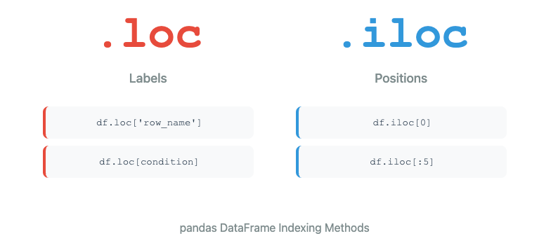
loc vs iloc
DataFrame
Sourece: medium article

Slide 35
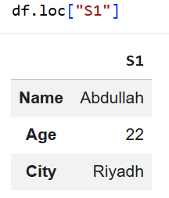
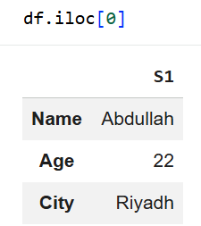
loc vs iloc
DataFrame
Access by Label
Access by Position

Slide 36
Summary
Pandas
A Python library for working with structured data.
Series
One-dimensional
Single column
Values + Index
DataFrame
Two-dimensional
Multiple columns
Collection of Series

